Slide 1
Visual Analytics– Intersection with AI Part 1
Dr. Ab Mosca (they/them)

Slide 2
Plan for Today
Definitions
ML
AI
Why do we care?
Explainable AI
ML for Vis

Slide 3
Defn: Machine Learning
Machine learning (ML) is a field of study in artificial intelligence concerned with the development and study of statistical algorithms that can learn from data and generalize to unseen data, and thus perform tasks without explicit instructions
Natural language processing
Computer vision
Speech recognition
Email filtering
Predictive analytics
https://en.wikipedia.org/wiki/Machine_learning#cite_note-1

Slide 4
Defn: Artificial Intelligence
Artificial intelligence (AI) is a field of research in computer science that develops and studies methods and software that enable machines to perceive their environment and use learning and intelligence to take actions that maximize their chances of achieving defined goals.
Search engines
Recommendation systems
Interacting via speech (ex. Siri)
Autonomous vehicles
Generative creative tools (ex. ChatGPT)
https://en.wikipedia.org/wiki/Artificial_intelligence#CITEREFRussellNorvig2021

Slide 5
Discussion
How do ML/AI intersect with Visual Analytics?

Slide 6
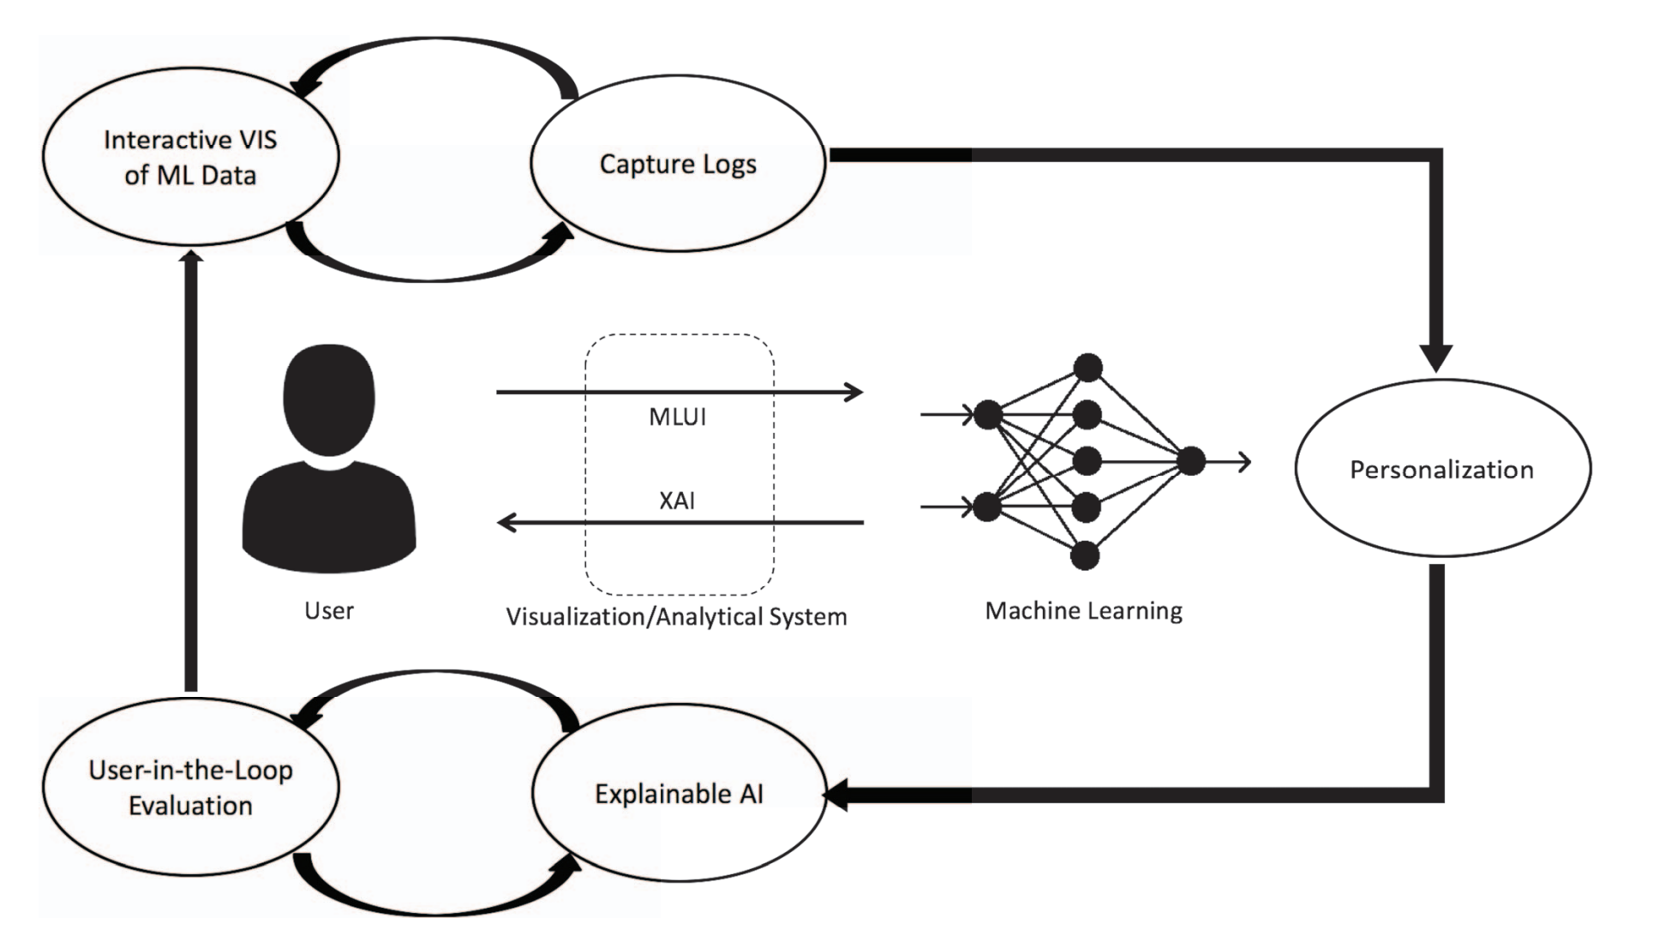
Intersection of AI and Vis
Machine Learning from User Interaction for Visualization and Analytics: A Workshop-Generated Research Agenda. 2019.
Notes:
five interconnected phases represented by each of the ovals:
a user interacting with a system (Interactive Visualization (VIS) of Machine Learning (ML) Data)
the system logging those interactions (Capture Logs)
the system learning from those interactions (Personalization)
the system communicating its learned response to the user (Explainable AI)
and the user interpreting that learned response (User-in-the-Loop Evaluation)
Each of these phases can be roughly categorized by whether the user performs the given phase, the visualization/analytical system, or machine learning within the system.

Slide 7
Machine Learning from User Interactions (MLUI)
Big Idea: visual analytic systems learn from user interactions to produce better analyses
How?
User interprets ML model using VA system
User interacts with VA system
VA system logs (one or more) interactions
Learning process is initiated
New ML model is communicated to user

Slide 8
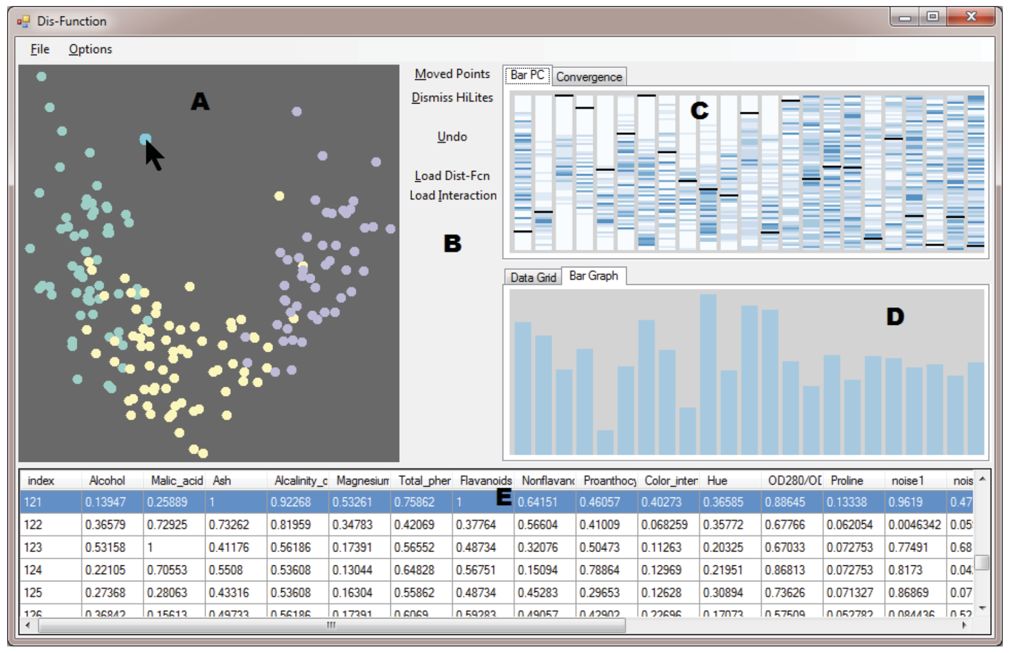
Machine Learning from User Interactions (MLUI)
Example: Dis-function Brown et al. 2012
MDS Scatter Plot of Data

Slide 9
Recall: MDS (Multidimensional Scaling)
Choose a good distance metric
Compute a pairwise distance matrix
Find a 2D embedding that preserves those distances

Slide 10
Machine Learning from User Interactions (MLUI)
Heatmap of value distribution in each dimension. Selected point is black line.
Example: Dis-function Brown et al. 2012
MDS Scatter Plot of Data
Raw data. Selected point is highlighted.
Notes:
. The one visible in the figure shows a bar graph representation of the current distance function. Each bar represents a dimension, and the bar height encodes the weight of that dimension

Slide 11
Machine Learning from User Interactions (MLUI)
Example: Dis-function Brown et al. 2012
Vis of distance function. 1 bar represents 1 dimension; height represents weight.

Slide 12
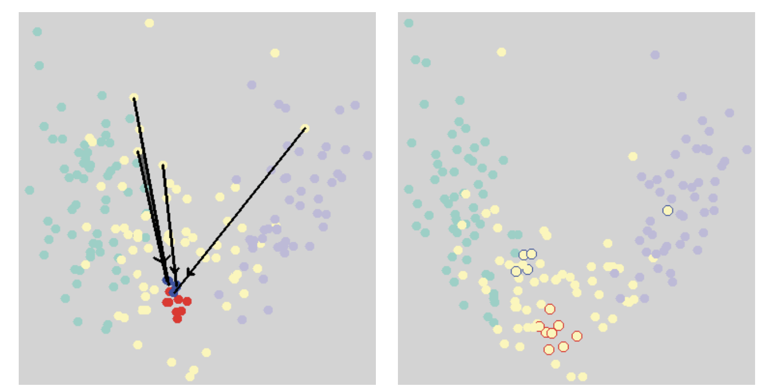
Machine Learning from User Interactions (MLUI)
Example: Dis-function Brown et al. 2012
Notes:
Updates

Slide 13
Machine Learning from User Interactions (MLUI)
Example: Lumos Narechania et al. 2021
Try it out: https://bit.ly/lumos-235-demo
Explore the data.
What does it show you as you explore?

Slide 14
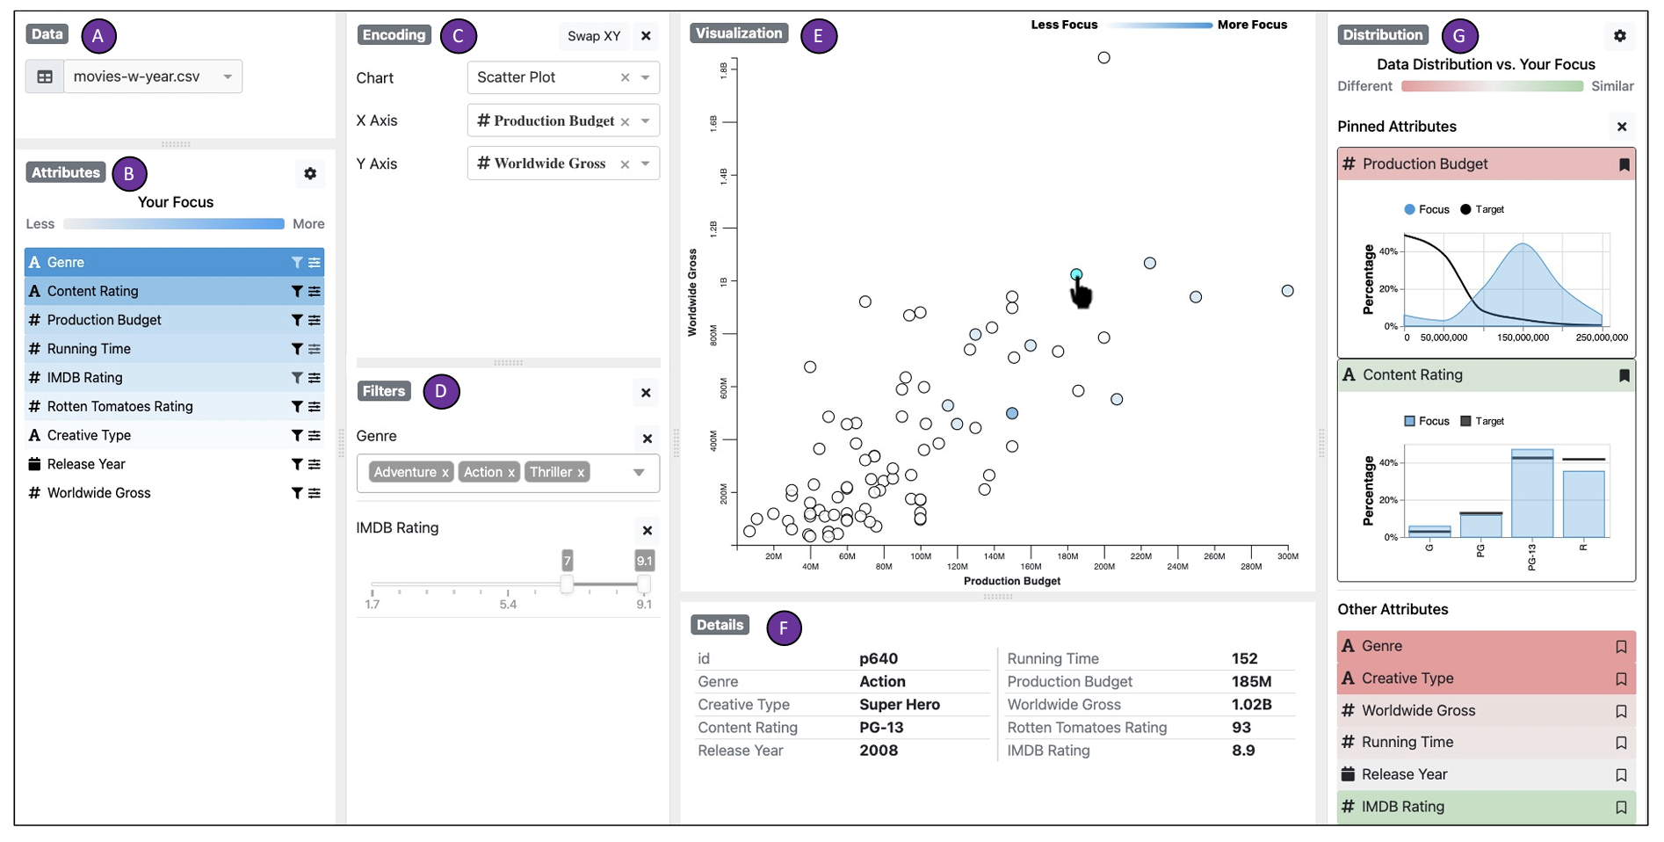
Machine Learning from User Interactions (MLUI)
Example: Lumos Narechania et al. 2021
Notes:
Shows what you’ve concentrated on to try to reduce bias

Slide 15
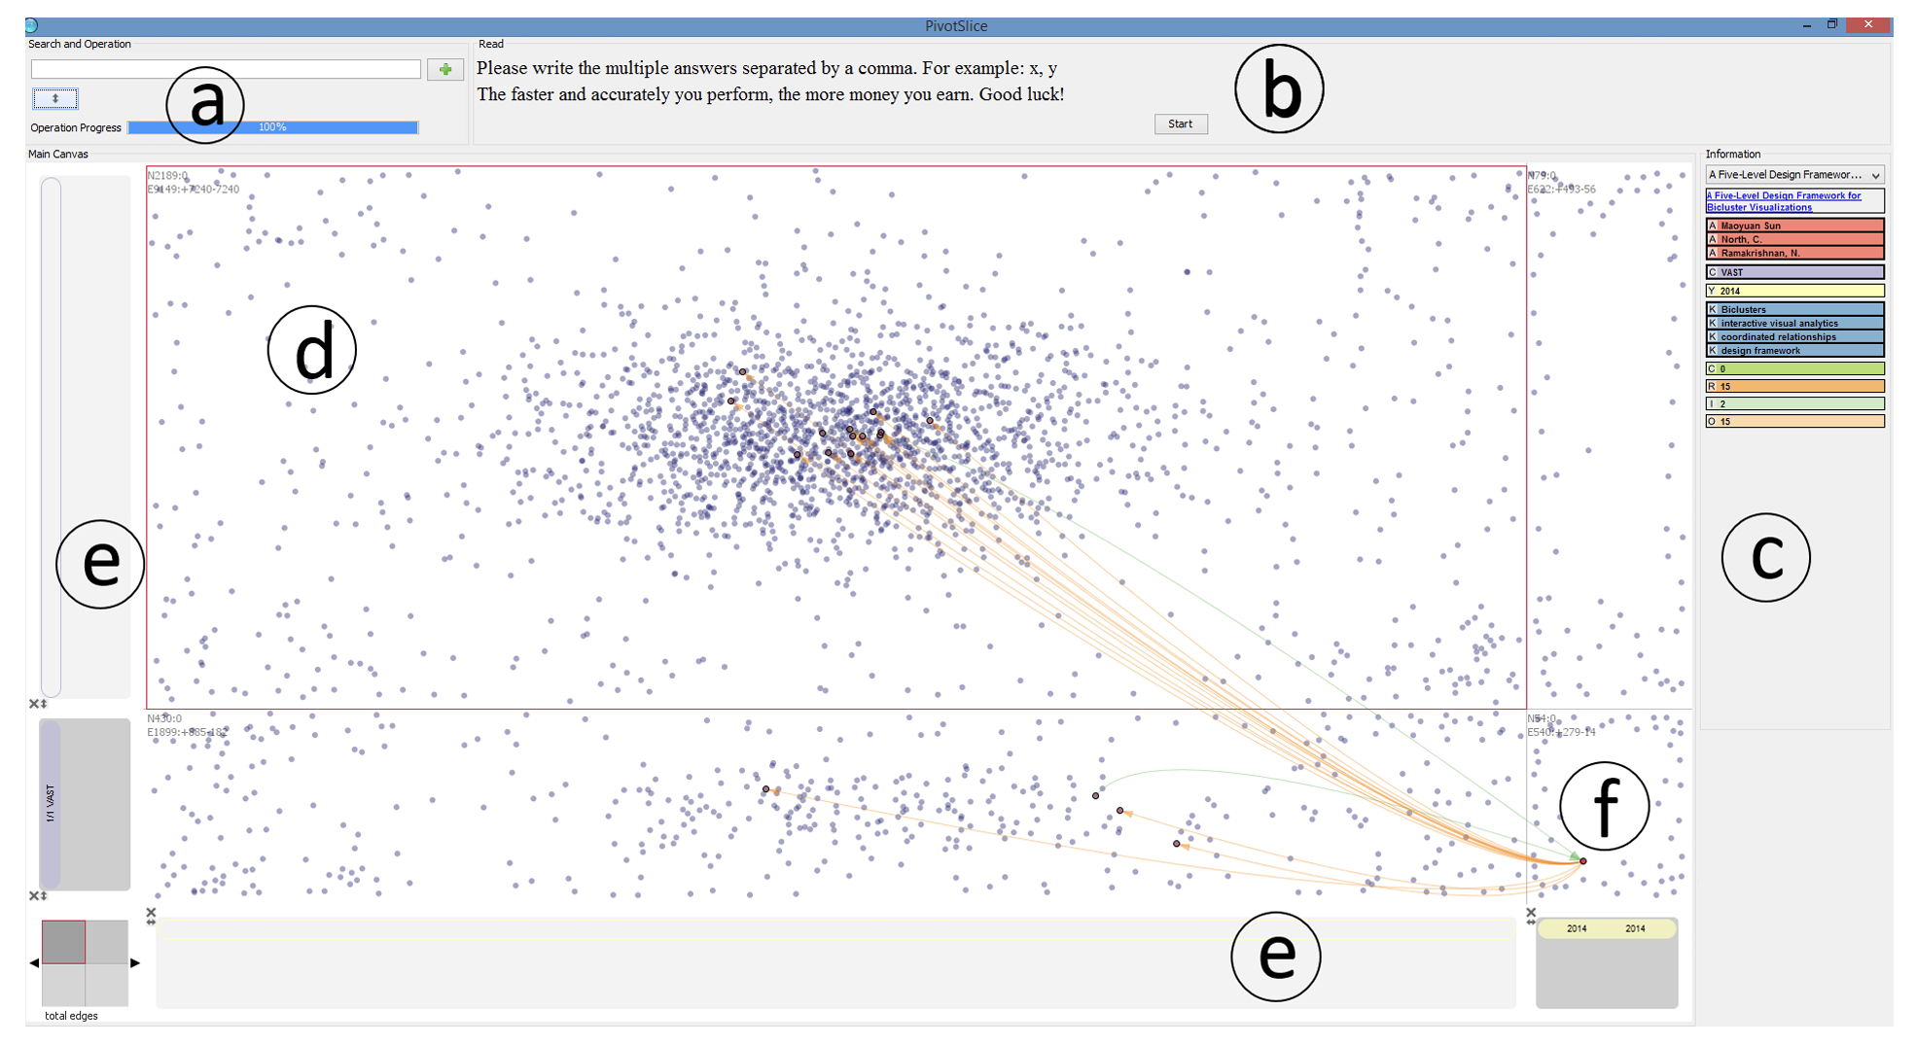

Machine Learning from User Interactions (MLUI)
Example: Contextual Assistance Panwar et al. 2018
Notes:
Shows what you’ve concentrated on to try to reduce bias

Slide 16
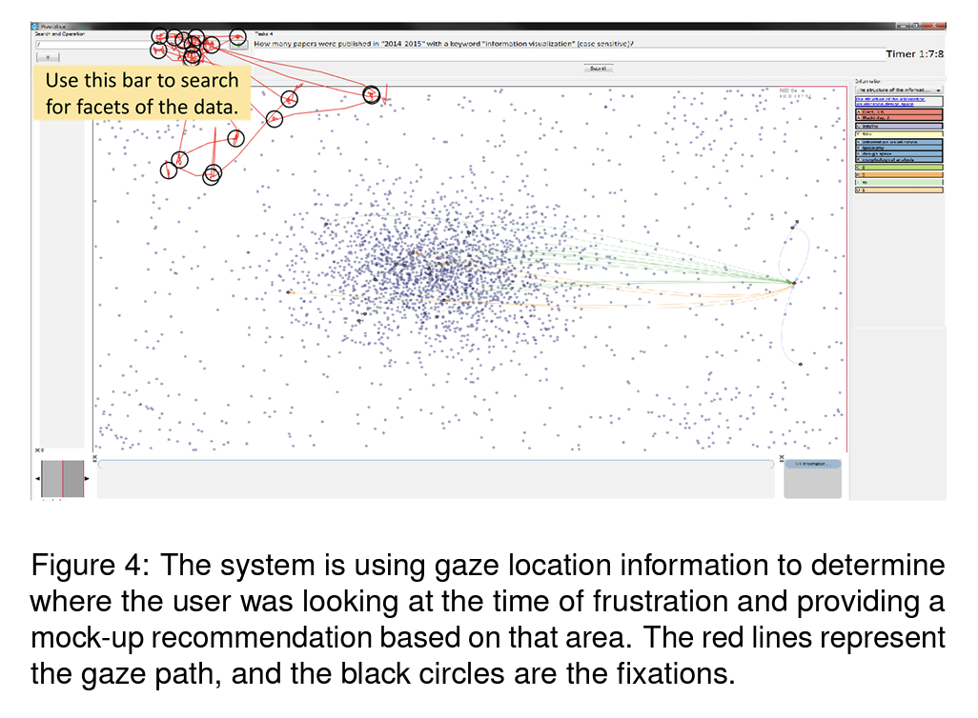
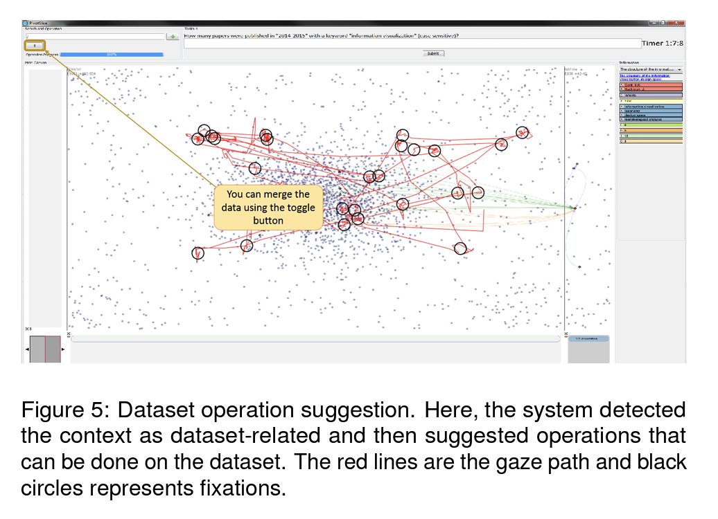
Machine Learning from User Interactions (MLUI)
Example: Contextual Assistance Panwar et al. 2018
Notes:
Shows what you’ve concentrated on to try to reduce bias

Slide 17
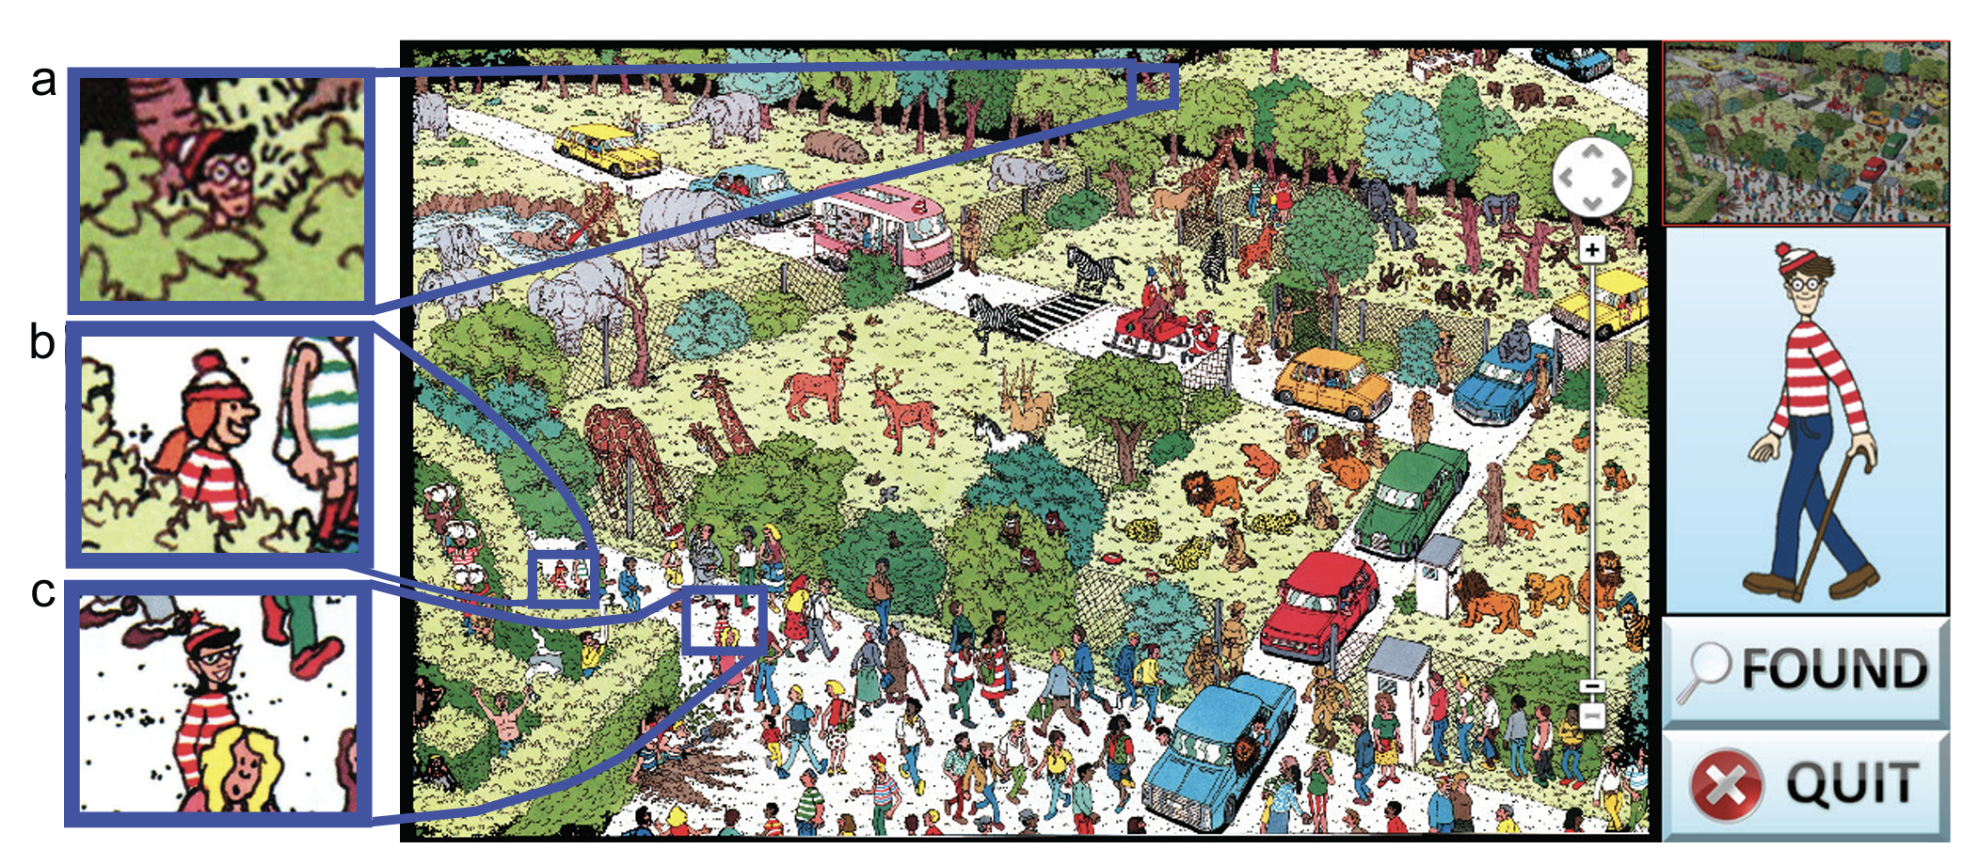
Machine Learning from User Interactions (MLUI)
Example: Finding Waldo Brown et al. 2014
Notes:
Shows what you’ve concentrated on to try to reduce bias

Slide 18
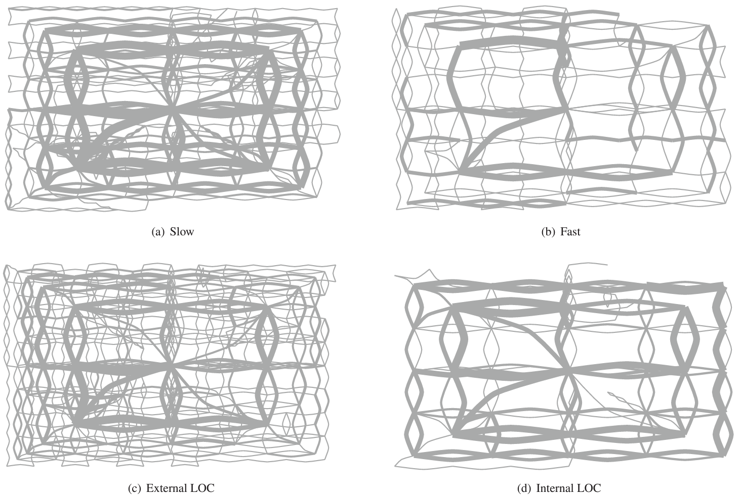
Machine Learning from User Interactions (MLUI)
Example: Finding Waldo Brown et al. 2014
Notes:
Shows what you’ve concentrated on to try to reduce bias

Slide 19
Machine Learning from User Interactions (MLUI)
Big Idea: visual analytic systems learn from user interactions to produce better analyses
How?
User interprets ML model using VA system
User interacts with VA system
VA system logs (one or more) interactions
Learning process is initiated
New ML model is communicated to user

Slide 20
Logging Interactions
Dis-function Brown et al. 2012
What did they need to log?

Slide 21
Logging Interactions
Example: Lumos Narechania et al. 2021
What did they need to log?
Notes:
Shows what you’ve concentrated on to try to reduce bias

Slide 22
Logging Interactions
Example: Contextual Assistance Panwar et al. 2018
What did they need to log?
Notes:
Shows what you’ve concentrated on to try to reduce bias

Slide 23
Logging Interactions
Example: Finding Waldo Brown et al. 2014
What did they need to log?
Notes:
Shows what you’ve concentrated on to try to reduce bias

Slide 24
Logging Interactions
Need to choose carefully about “what” to capture
What input steams do we want?
Clicks?
Eye gaze?
Mouse strokes
Is there important context?
Do we need pixel location?
Do we need associated data point?
Do we need associated interface element?
Notes:
Shows what you’ve concentrated on to try to reduce bias

Slide 25
Machine Learning from User Interactions (MLUI)
Big Idea: visual analytic systems learn from user interactions to produce better analyses
How?
User interprets ML model using VA system
User interacts with VA system
VA system logs (one or more) interactions
Learning process is initiated
New ML model is communicated to user

Slide 26
Intersection of AI and Vis
Machine Learning from User Interaction for Visualization and Analytics: A Workshop-Generated Research Agenda. 2019.
Notes:
five interconnected phases represented by each of the ovals:
a user interacting with a system (Interactive Visualization (VIS) of Machine Learning (ML) Data)
the system logging those interactions (Capture Logs)
the system learning from those interactions (Personalization)
the system communicating its learned response to the user (Explainable AI)
and the user interpreting that learned response (User-in-the-Loop Evaluation)
Each of these phases can be roughly categorized by whether the user performs the given phase, the visualization/analytical system, or machine learning within the system.

Slide 27
Discussion
First a step back…
Where is AI currently used for decision making?

Slide 28
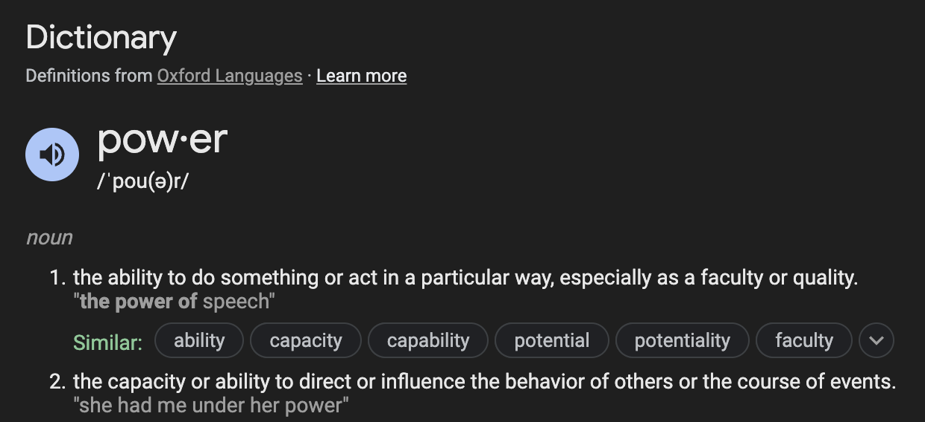
Power
When AI is used for decision making, who holds more power, the person making the decision or the person affected by it?

Slide 29
Explainable AI (XAI)
Big idea:
If AI is going to be used for decision making, we must be able to explain how it produces its decisions.
Using visualization to communicate the inner workings of an AI model is one avenue towards XAI.

Slide 30
Explainable AI (XAI)
Let’s explore:
Annual Workshop for Visualization for AI Explainability: https://visxai.io/
Pair up with 1-2 classmates
Choose an XAI Vis from the Hall of Fame (bottom of the website)
Explore the vis
Using only the XAI Vis, create a 5 minute presentation that teaches others how the model works (be prepared to share!)

